Slide 1
BANK MANAGEMENT SYSTEM in c++
made BY:
NAME: mohd suhaib khan (086) , suhail khan(143), rohit rathaur(123), syed Rahib(148)
sec - B btech 3rd year cse

Slide 2
CERTIFICATE
This is to certify that Project report entitled “Bank Management System in c++”, submitted by Mohd Suhaib Khan , Suhail Khan , Rohit Rathaur and Syed Rahib for partial fulfilment of the requirement for the award of degree Bachelors of Technology in Department of Computer Science & Engineering of Dr. A.P.J Abdul Kalam University, Lucknow is a record of the candidates’ own work carried out by them under my supervision. The matter embodied in this report is original and has not been submitted for the award of any other degree.
Date: 6/12/2021 supervisor:
ASHISH JAIN SIR

Slide 3
INTRODUCTION
"BANK MANAGEMENT SYSTEM" This project is useful for the bank employees as well as customers to keep a track of account details. The emerging of digital system made information available on finger tips. By automating the transactions one can view the details as and when required in no time. This project emphases on creation of new customer accounts, managing the existing account holders in the bank, by making digital system one can generate daily reports, monthly reports and annual reports which can enhance the system.

Slide 4
WHAT IS A BANK ACCOUNT?
A bank account is a financial account maintained by a bank or other financial institution in which the financial transactions between the bank and a customer are recorded. Each financial institution sets the terms and conditions for each type of account it offers, which are classified in commonly understood types, such as deposit accounts, credit card accounts, current accounts, loan accounts or many other types of account. A customer may have more than one account. Once an account is opened, funds entrusted by the customer to the financial institution on deposit are recorded in the account designated by the customer.Funds can be withdrawn from loan loaders.

Slide 5
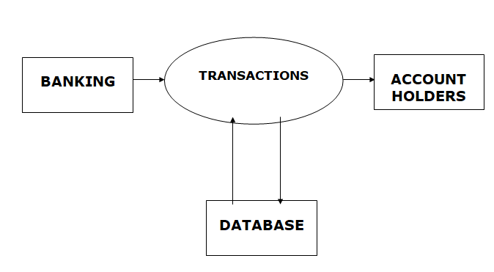

Slide 6
WHAT IS A BANKING RECORD?
The bank account record stores all bank account information you need to track and manage, such as account and routing numbers, current and minimum balances, bank details, adjustment categories, as well as any notes you want to associate with the bank account.From the bank account record, you can add alerts and adjustments, open the register, reconcile, and close accounts. We can use the bank record to keep track of our bank activity ,reconciliations and how the bank account is performing. To view the bank record go to Banking then click the required bank account.

Slide 7
WHY ARE BANK STATEMENTS IMPORTANT? 1 Budgeting and Financial Planning A bank statement is like a personal P&L statement. It allows account holders to keep track of their finances and plan for future expenditures. Bank statements are also extremely helpful forbudgeting, as they allow account holders to decipher how muchthey are spending on different categories. 2 Reconciliation and Identification Once the bank prepares a bank statement or e-statement at the end of the month, account holders are usually given 30-60 days to analyze the charges and reconcile their cash balance.Since the bank statement contains all charges, along with the corresponding dates and payees, it can help account holders identify any fraudulent activity. 3 Credit Verification Bank statements can also be useful to analyze the credit worthiness of the account holder. Most banks and financial institutions require verification of bank statements for the last 2-5 years before giving loans to individual clients.Banks use the individual’s bank statements and other credit documents to analyze the credit worthiness of the borrower. Itapplies to most types of loans, including residential mortgages, student loans, and loans for small businesses.

Slide 8
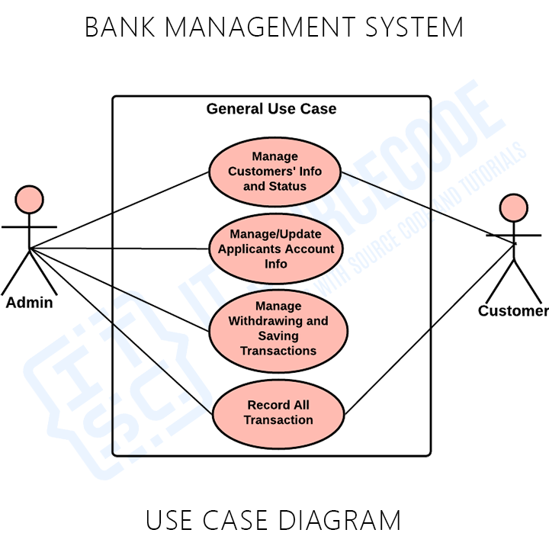

Slide 9
PROJECT CATEGORY: Language description The project is based on the concepts of C++ Programming.
ABOUT THE PROGRAMMING LANGUAGE:
C++ is a general-purpose programming language that was developed as an enhancement of the C language to include object-oriented paradigm. It is an imperative and a compiled language. C++ is a middle-level language rendering it the advantage of programming low-level (drivers, kernels) and even higher-level applications (games, GUI, desktop apps etc.). The basic syntax and code structure of both C and C++ are the same. Some of the features & key-points to note about the programming language are as follows:
Simple:
It is a simple language in the sense that program scan be broken down into logical units and parts, has a rich library support and a variety of data-types.

Slide 10
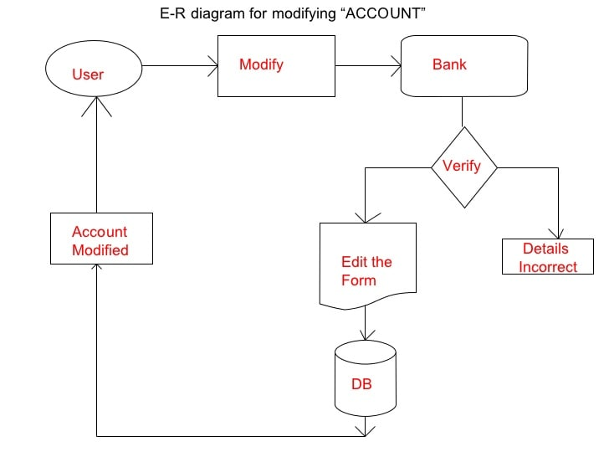

Slide 11
OBJECTIVES: The researcher aims to create or develop a system that is capable and reliable in the whole record about the customer,retrieving and storing data in an appropriate way.In particular it aims to the
Banking Record System serves the following objectives:
Provide a database that will store information. Develop a system that will lessen process delay in terms of customer’s record. Make an easy to use environment for users and customers.Provides a convenient solution of record pattern. Add and maintain new entered category of records. Add and maintain customer details. Search the customer using numbers of existing record. Show the details of record from files. Show the details of programmer after exit.

Slide 12
USER DEFINED FUNCTIONS USED: File handling has been effectively used for each feature of this project. Here, I am going to describe these features in brief.
Add Record: For this feature void read_data() function has been used to add banking record into the file. It asks for information such as account number, first name, last name and balance to be entered.
Show/List Data: With the information provided in addrecord, the void show_data() function in this banking record system project in C++ show the record corresponding to a particular account number, first name and last name. Current balance of the account holder is displayed.
Search Record: When the function for this feature is first executed, it shows the total records in the file, and the user can then search by record number. If the record searched for is not found, the banking record system project in C++ displays the message “Error in opening! File Not Found!!”
Edit Record: This works in similar manner to the Search feature. When the function for Edit Record is first executed ,I t shows the total records in the file, and the user can edit the information by providing record number.

Slide 13
MODULES USED IN PROJECT Bank management System application is so simple to use. In order to use the application, you can run it directly using code and then, you will have 5 options to
1:to create account
2: to deposit fund
3: to check balance
4: to close an account
5: to exit the program
As per your need, enter 1, 2, 3, 4, 5 and follow the instructions provided by the application itself.

Slide 14
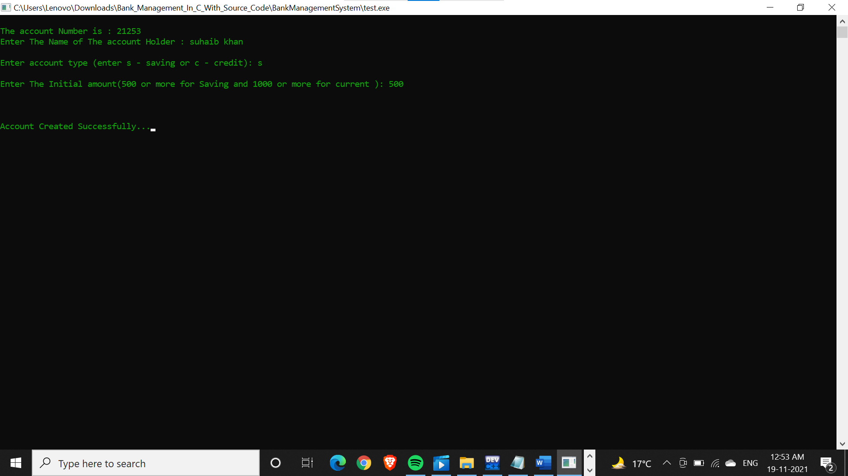
OUTPUT SCREEN
Press 1= to create account

Slide 15
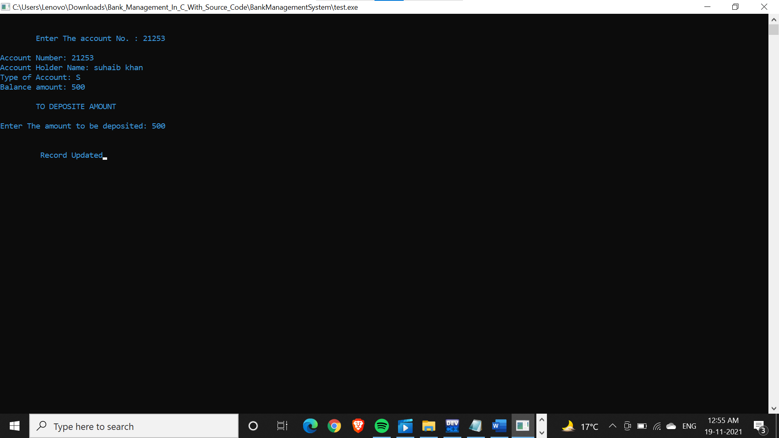
press 2 = to deposit fund

Slide 16
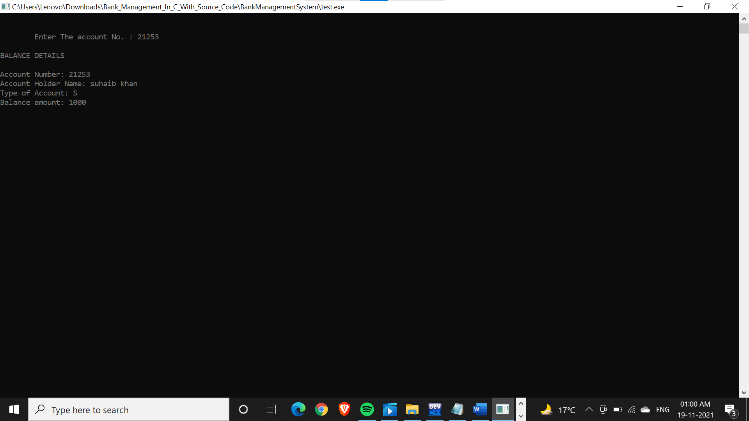
Press 3= to check balance

Slide 17
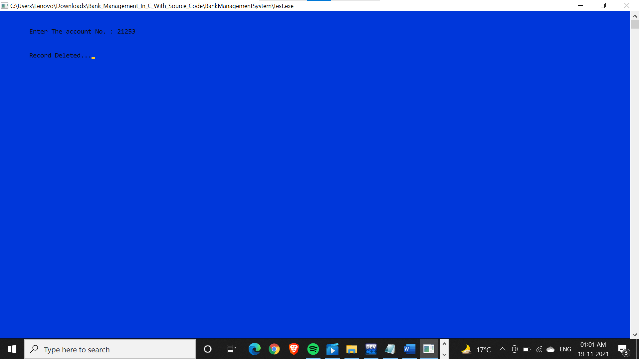
Press 4= to close an account

Slide 18
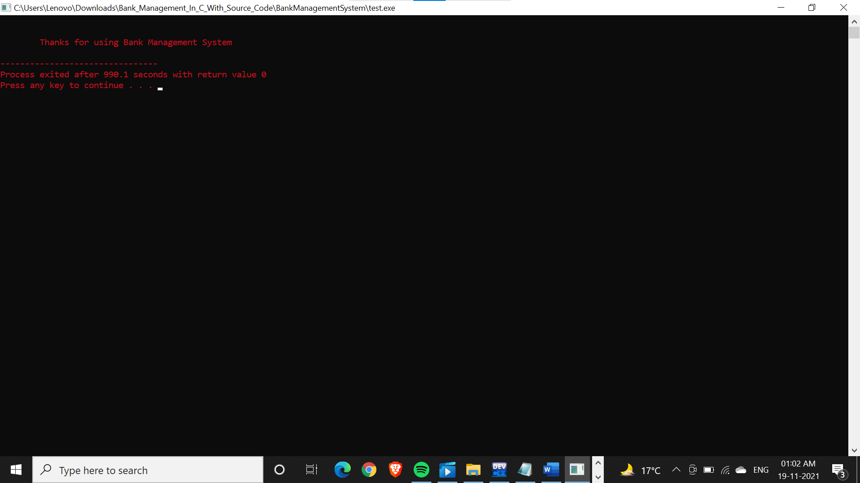
Press 5= to exit the program

Slide 19
FUTURE SCOPE
1.This project will help the bankers in fast reporting.
2.This project enable banker to maintain a great database of all Customer ’ s details from the software.
3.Project will enable to see report regarding query.
4. It is easy to maintain in future prospect

Slide 20
CONCLUSION
This was our project about “Banking management System”. Development of this System takes a lot of efforts. I think this system gave a lot of satisfaction. Though every task is never said to be perfect in this development field even more improvement may be possible in this system. I learnt so many things and gained a lot of knowledge about development field. I hope this will prove fruitful.

Slide 21
bibliography
1.Books referred = we have referred c++ programming book from pragya publication
2.Websites referred = google.com , stackoverflow.com, geeksforgeeks.com , javatpoint.com.

Slide 22
THANK YOU

